Slide 1
PennyTrack - an Intuitive Expense Tracker Application
PIP2001 Capstone Project
Review-3
Batch Number: CIT G-11
Under the Supervision of,
Dr./Mr./Ms./Prof. Dr. Shanthi S
Professor / Associate Professor / Assistant Professor
School of Computer Science and Engineering
Presidency University
Roll Number
20211CIT0046
20211CIT0051
20211CIT0088
Student Name
Abdul Aman Khan Rehan Ashraf
Mihir Suman
Name of the Program: B.Tech CSE-IoT
Name of the HoD: Dr. Anandraj SP
Name of the Program Project Coordinator:
Name of the School Project Coordinators: Dr. Sampath A K / Dr. Abdul Khadar A / Mr. Md Ziaur Rahman

Slide 2
Introduction
In today's digital age, where smartphones are ubiquitous, the Expense Tracker project introduces a revolutionary Android-based financial management solution. This application addresses the limitations of traditional expense tracking methods, replacing manual diary entries and error-prone spreadsheets with an automated digital diary system. The project aims to streamline daily and monthly expense monitoring, catering to both individual users and organizations.
The Expense Tracker application begins with a user-friendly registration process, where each user is assigned a unique ID. This personalized approach allows for accurate and individualized financial tracking. Once registered, users input their income, which the app intelligently allocates into daily expense allowances. The system's dynamic nature shines in its ability to adjust these allowances based on actual spending patterns. When users underspend, the excess amount is automatically added to their savings, while overspending triggers a recalculation of future allowances, ensuring consistent budget management.

Slide 3
Introduction
Key features of the Expense Tracker include:
1. Comprehensive analysis of expenses on daily, monthly, and yearly bases
2. Visual representation of financial data through multiple graph formats
3. Customizable report generation in Excel, PDF, and printable formats
4. Advanced data mining capabilities for income and expenditure predictions
5. Integrated savings tracking and management
6. User-defined expense limits and categories
Developed using the Software Development Life Cycle methodology and leveraging IBM Cloud Services, the application ensures a robust, scalable, and user-friendly experience. The interface is designed for intuitive navigation, minimizing the learning curve for new users.

Slide 4
Introduction
For organizations, the Expense Tracker offers systematic budgeting tools and efficient expense handling, crucial for stakeholders in managing organizational expenditures. It simplifies the often complex task of financial oversight, providing clear insights into spending patterns and potential areas for cost optimization.
By providing real-time insights into spending habits, the Expense Tracker empowers users to make informed financial decisions, prevent budget crises, and maintain long-term financial stability. The application's predictive capabilities assist in future financial planning, while its comprehensive reporting features offer a clear view of one's financial health.
In essence, this project not only simplifies expense management but also promotes financial literacy and responsible spending habits in our increasingly digital world. By harnessing the power of mobile technology, the Expense Tracker transforms the challenge of personal finance management into an accessible, efficient, and even engaging daily practice.

Slide 5
Literature Review
Angad Manchanda, "Expense Tracker Mobile Application" (2012, IEEE): This expense tracker application helps users monitor their expenses effectively. An additional feature of this application is its ability to help users cut down unnecessary expenses, promoting a more responsible and financially sound lifestyle.
Girish Bekaroo and Sameer Sunhaloo, "Intelligent Online Budget Tracker" (16 June 2014, IEEE): The Intelligent Online Budget Tracker allows for online tracking of financial activities, ensuring a clear plan for managing budgets. The system provides users with the convenience of accessing their financial data securely from anywhere using the internet, enabling budget management at home or on the go.
Namita Jagtap, Priyanka Joshi, and Aditya Kamble, "A Review on Budget Estimator Android Application" (April 2019, IEEE): This project focuses on a budget estimator system that utilizes geographical tracking. Based on the user's location, it notifies them of nearby stores and relevant offers through Google services. For added security, the application includes a login authentication feature that sends an OTP to the user's device, enhancing trust and confidence in the system.

Slide 6
Literature Review
Hrithik Gupta, Anant Prakash Singh, Navneet Kumar, and Ms. J. Angelin Blessy, "Expense Tracker: A Smart Approach to Track Everyday Expense" (Dec 25, 2020, IEEE): This expense tracker application is designed to manage and control users' savings and expenses on a daily, monthly, or annual basis. It offers multiple language options for better accessibility and provides an intuitive interface. The primary feature of this application is its capability to track expenses on a daily basis, allowing users to categorize and manage their expenses efficiently.
Dr. V. Geetha, G. Nikhitha, H. Sri Lasya, and Dr. C.K. Gomathy, "Expenditure Management System" (16 May 2022, IEEE): This application simplifies day-to-day expense tracking by eliminating the need for pen and paper, ensuring that data is not lost. Users can manage their savings and expenses on both a daily and annual basis. Additionally, the system notifies recipients when a money transfer occurs, along with details of the transfer purpose, enhancing transparency and communication during financial transactions.

Slide 7
Existing method Drawback
Manual Record Keeping
Time-consuming process of writing down every expense
Prone to human error in recording and calculations
Difficult to maintain consistency over long periods
Paper-based Systems
Risk of physical damage or loss of records
Limited portability and accessibility
Challenging to organize and retrieve specific information quickly
Basic Spreadsheets
Require manual data entry and formula management
Limited data visualization capabilities
Lack of real-time updates and notifications

Slide 8
Existing method Drawback
Lack of Categorization
Difficulty in identifying spending patterns across different categories
Challenges in budget allocation without clear expense categorization
Absence of Real-time Tracking
Delayed awareness of overspending
Inability to make immediate financial decisions based on current status
Limited Analytical Capabilities
Lack of automated insights and spending trend analysis
Difficulty in generating comprehensive financial reports
Inefficient Data Storage
Risk of data loss or corruption in non-digital systems
Challenges in maintaining long-term financial history

Slide 9
Existing method Drawback
Absence of Multi-device Synchronization
Inability to access or update financial information across different devices
Inconsistency in data when using multiple tracking methods
Security Concerns
Vulnerability of physical records or unsecured digital files to theft or unauthorized access
Lack of encryption for sensitive financial data
Limited Collaboration Features
Difficulty in sharing financial information with family members or financial advisors
Challenges in maintaining shared budgets or expenses
These drawbacks highlight the need for a modern, digital solution like the proposed Expense Tracker application, which addresses these issues through automation, real-time tracking, and advanced analytical features.

Slide 10
Proposed Method
Web Application for Multi-Device Synchronization
Seamless task transition between devices.
Intuitive UI/UX with responsive design and customizable dashboards.
Accessibility features and interactive elements for easy data management.
Income Tracking
Log multiple income sources and support recurring entries.
Visualize income trends and calculate net income after expenses.
Provide insights on income allocation and savings suggestions.
Weekly and Monthly Analysis
Generate visual reports with pie charts and trend analysis.
Compare actual spending against budgeted amounts.
Highlight top spending categories and offer flexible reporting periods.

Slide 11
Proposed Method
Expense Categorization and Budgeting
Automatically categorize expenses into predefined or custom categories.
Set budgets for each category and track spending against those limits.
Provide alerts for overspending and suggest adjustments to stay within budget.
Comprehensive Financial Planning Tools
Offer retirement planning tools with savings and investment analysis.
Provide tax optimization strategies to minimize liabilities.
Offer debt management tools with payoff visualizations and strategies.
Investment Tracking and Analysis
Track portfolios across asset classes and provide performance metrics.
Offer risk assessment and diversification strategies based on goals.
Provide educational insights for informed investment decisions.

Slide 12
Proposed Method
App Authentication
Implement robust security measures with authentication (JWT, BCrypt).
Support two-factor authentication and encrypt stored financial data.
Offer secure cloud backup options to prevent data loss.
E-wallet for Future Transactions
Analyze spending patterns and suggest funds for future expenses.
Allow easy fund transfers between e-wallet and bank accounts.
Provide insights on savings optimization based on predicted transactions.

Slide 13
Objectives
Streamline Expense Management: Replace traditional manual methods of tracking expenses, such as diaries and spreadsheets, with a modern, automated Android application that simplifies personal and organizational financial management.
Promote Financial Literacy and Responsible Spending: Encourage users to develop healthy financial habits by providing real-time insights, helping them make informed financial decisions and avoid budget crises.
Personalized Financial Tracking: Create a user-centric experience by assigning each user a unique ID, allowing individualized tracking of income and expenses, with automatic adjustments to daily allowances based on actual spending patterns.

Slide 14
Objectives
Facilitate Budget Optimization for Organizations: Provide organizations with tools for systematic budgeting, expense handling, and financial oversight to optimize cost management and improve financial control.
Enable Predictive Financial Planning: Leverage data mining and predictive features to assist users in forecasting future income and expenditures, facilitating long-term financial planning.
Incorporate Advanced Savings Management: Automatically adjust savings based on spending behavior, helping users manage their savings effectively.
Ensure Robust and Scalable Performance: Utilize the Software Development Life Cycle methodology and Cloud Services to develop a reliable, scalable, and user-friendly application that minimizes the learning curve and enhances user satisfaction.

Slide 15
Methodology/Modules
Landing Module
Authentication Module
User Dashboard Module
Income Module
Expense Module
Budgeting Module
Investment Module

Slide 16
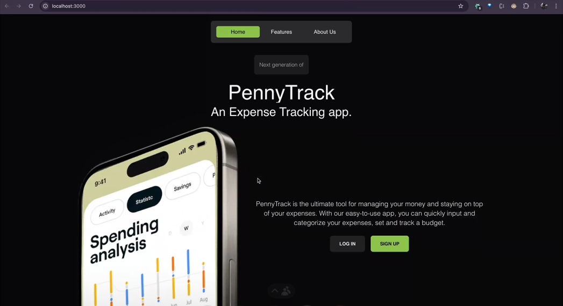
Methodology/Modules
Landing Module

Slide 17
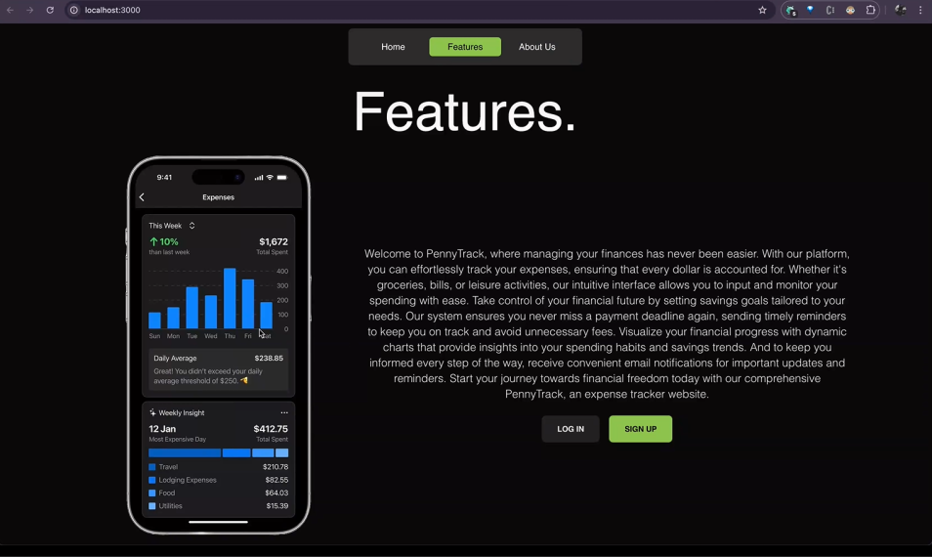
Methodology/Modules

Slide 18
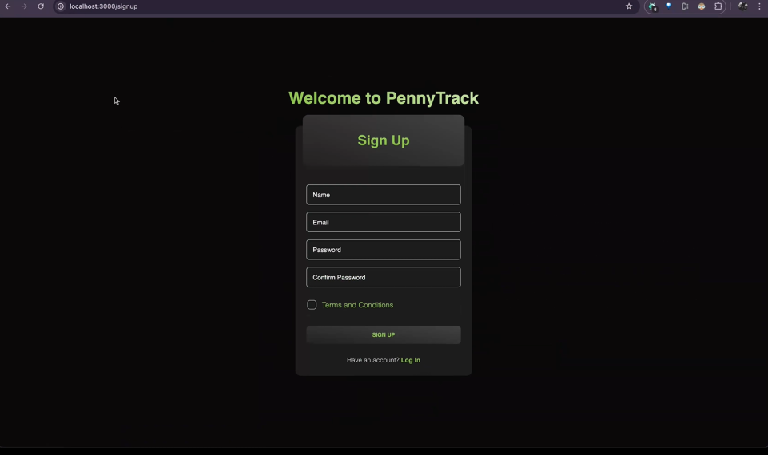
Methodology/Modules
Authentication – Sign Up

Slide 19
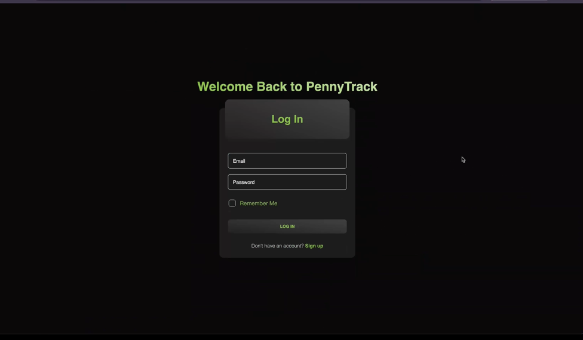
Methodology/Modules
Authentication - Login

Slide 20
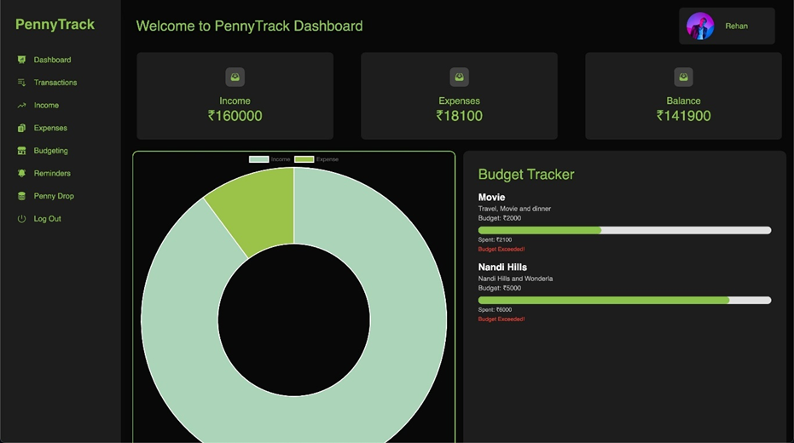
Methodology/Modules
User Dashboard Module

Slide 21
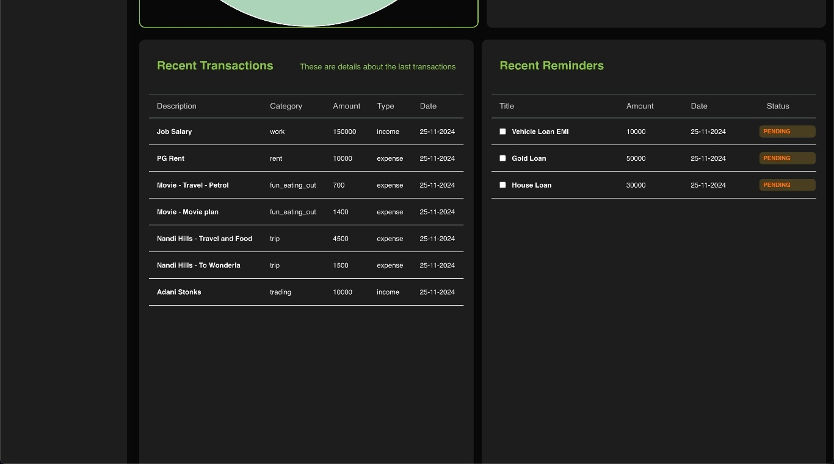
Methodology/Modules
User Dashboard Module

Slide 22
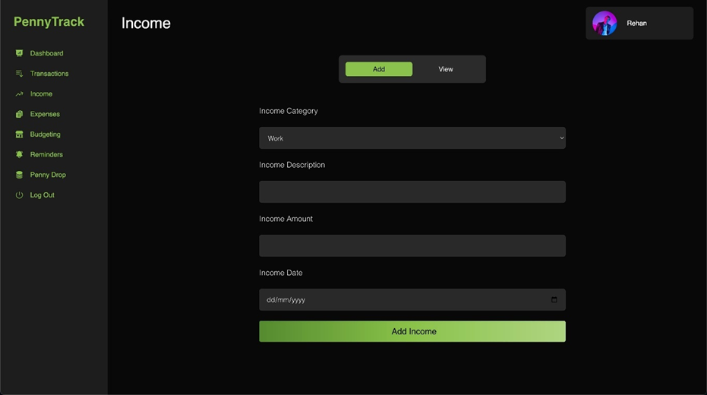
Methodology/Modules
Income Module

Slide 23

Methodology/Modules
Expense Module

Slide 24
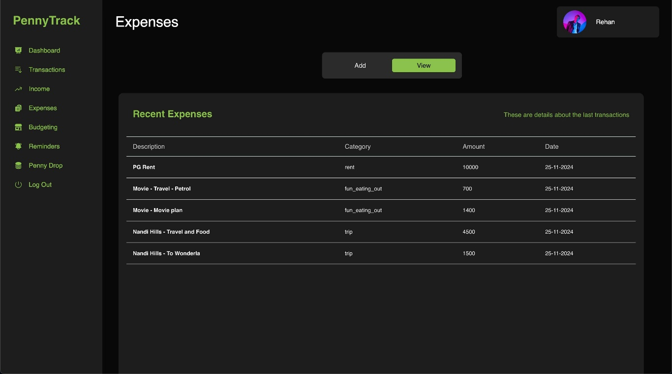
Methodology/Modules
Expense Module

Slide 25
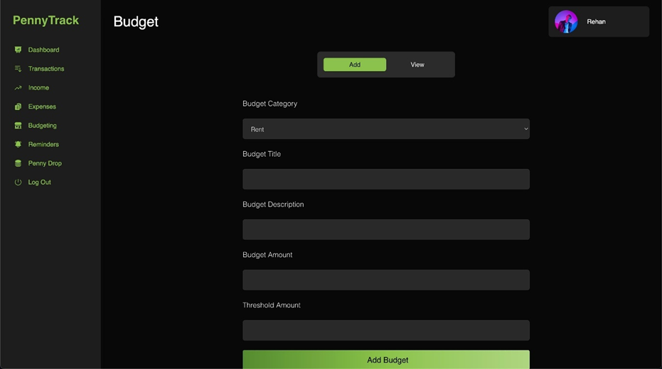
Methodology/Modules
Budget Module

Slide 26
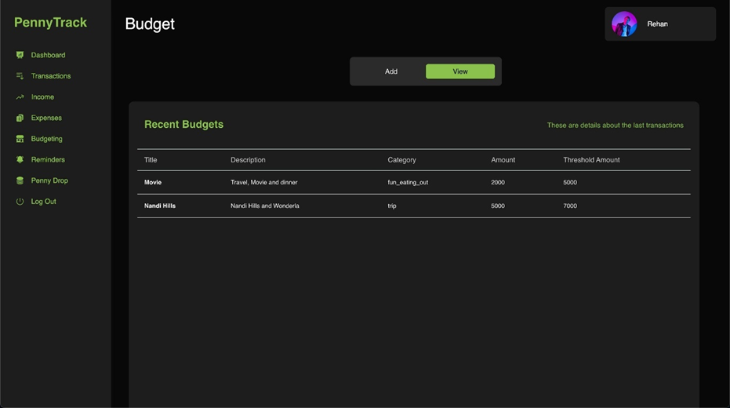
Methodology/Modules
Budget Module

Slide 27
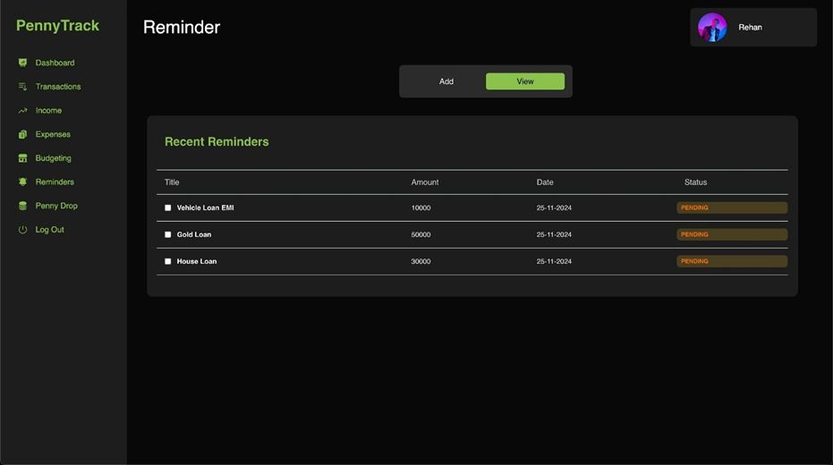
Methodology/Modules
Reminder Module

Slide 28
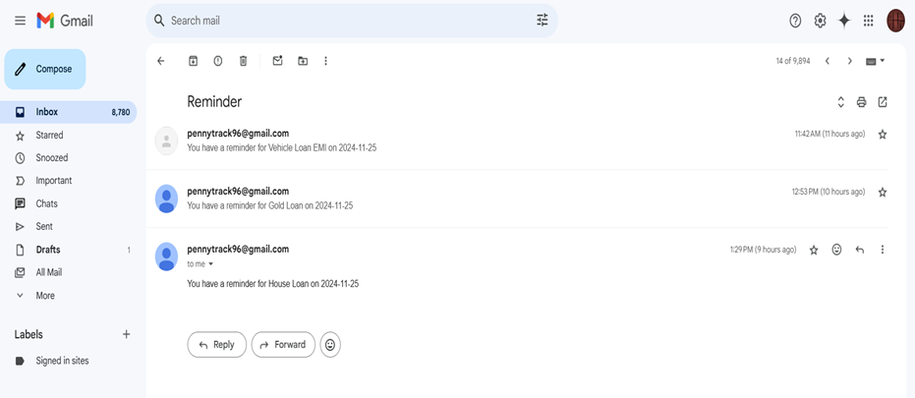
Methodology/Modules
Reminder Module

Slide 29
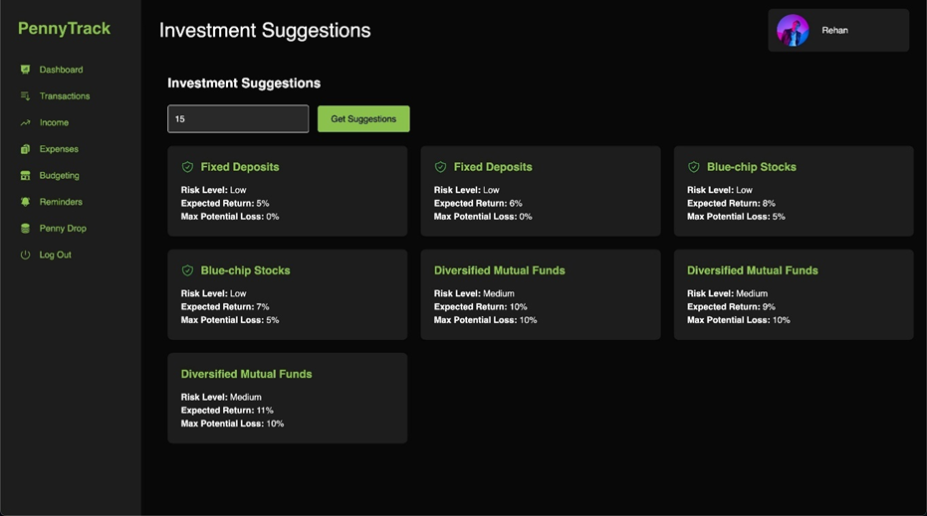
Methodology/Modules
Investment Module

Slide 30
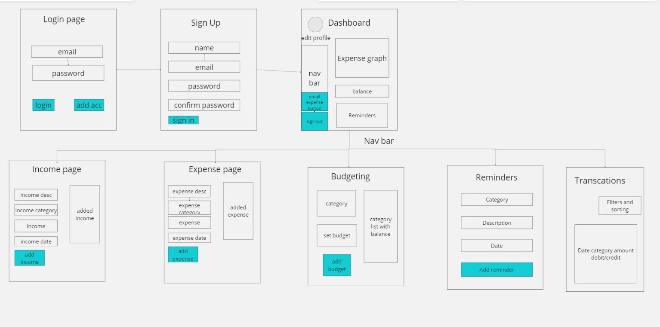
Architecture

Slide 31
Hardware/Software components
Software Requirements
Backend (Node.js, Express, MongoDB)
Operating System: Windows, macOS, or Linux
Node.js: v12.x or higher
MongoDB: Local or cloud-based (e.g., MongoDB Atlas)
npm (Node Package Manager): v6.x or higher
Frontend (NextJS,ReactJS)
Node.js: v12.x or higher
npm or yarn: For managing dependencies
Browser: Modern browsers (Chrome, Firefox, Edge)
Development Tools
Code Editor: Visual Studio Code (recommended)
Version Control: Git for source control (GitHub or similar)

Slide 32
Hardware/Software components
Hardware Requirements
For Local Development
Processor: Intel Core i5 (minimum)
RAM: 8 GB RAM (minimum)
Storage: 10 GB free space
Network: Stable internet connection for development and API testing
For Hosting/Production
Processor: Dual-core processor (minimum)
RAM: 2 GB (minimum)
Storage: 10 GB
Deployment/Hosted Services
MongoDB Atlas: Cloud-hosted MongoDB service, reducing the need for local DB
Docker, Kubernetes: Containerization and Orchestration of Docker images.
AWS, or DigitalOcean: For hosting the MERN application in the cloud

Slide 33
Expected Outcomes
Enhanced Financial Awareness: Users gain insights into their spending habits, improving financial decision-making.
Simplified Expense Tracking: Automated tracking reduces the need for manual entry in diaries or spreadsheets.
Consistent Budget Management: Daily allowances are adjusted based on spending patterns to maintain a balanced budget.
Improved Financial Stability: Informed financial choices help users avoid budget crises and foster long-term stability.
Better Organizational Financial Control: Organizations benefit from systematic budgeting and expense management tools for better oversight.
User Satisfaction through Intuitive Design: A user-friendly interface ensures ease of use and encourages regular engagement.
Increased Savings: Automated savings tracking redirects unspent daily allowances into savings, promoting financial growth.

Slide 34
Conclusion
The Expense Tracker project revolutionizes personal and organizational financial management by offering a user-friendly, Android-based solution that simplifies expense tracking. By automating the process, users can effortlessly monitor their income, expenses, and savings while gaining valuable insights into their spending habits.
The application's predictive capabilities, customizable reports, and real-time financial feedback empower users to make informed decisions and maintain financial stability.
For organizations, it streamlines budgeting and cost management, providing a clearer path to financial optimization. With its intuitive interface, scalability, and reliance on advanced technology, the Expense Tracker not only promotes responsible spending but also enhances financial literacy, making personal finance management accessible and engaging in the digital age.

Slide 35
Github Link
The Github link provided should have public access permission.
Github Link
https://github.com/Neverm1ndEZ/captsone-project

Slide 36
References
http://oaji.net/articles/2017/1948-1513926576.pdf
http://www.appbrain.com/app/expensemanager/com. expensemanager.
http://expense-manager.com/how-expensesoftware
https://www.splitwise.com/terms
Textbook-Data Mining: Concepts and Techniques (3rd Edition)by J. Han, M. Kamber, and J. Pei -- Morgan Kaufmann Publ. 2012 ISBN: 978-0-12-381479-1
IEEE Transactions on software engineering, vol. 31, No. 3, March 2005 [7]R. Pressman, software engineering A practitioner’s approach. Fifth edition McGrawHill, 2001

Slide 37
References
Dr. V. Geetha, G. Nikhitha, H. Sri Lasya and Dr. C.K. Gomathy," Expenditure Management System”,16 May 2022, IEEE
Aman Garg, Mukul Goel, Sagar Mittal, Mr. Shekhar Singh4, Apr 2021, Expense Tracker, International Journal for Research in Applied Science & Engineering Technology (IJRASET),9(IV), pp.1067-1070.
“Online- Income and ExpenseTracker ”, IRJET, Vol:06 Issue: 3, e-ISSN: 2395-0056, p-ISSN: 2395

Slide 38
Thank You

